Slide 1
Fire Weather Data Visualization
By team 1 ( Abdullatif & Ben )

Slide 2
Suggested Work Plan
1- Obtain and Understand Datasets
2- Exploratory Data Analysis (EDA)
Data preparation (Data cleansing and imputation)
General analysis
3- Data Modeling (Forecasts from either the temporal or spatial regression model)
4- Model Evaluation (Evaluate the autocorrelation)
5- Visualization (Shiny App using Rstudio or Folium using Python)

Slide 3
Obtain & Understand Datasets
1- Weather_Stations_Data_US
From: National Interagency Fire Center
Link: https://data-nifc.opendata.arcgis.com
Period: Dec,2021 - Aug,2022
2- Wildland_Fire_Locations_US
From: National Interagency Fire Center
Link: https://data-nifc.opendata.arcgis.com
Period: April,2009 - Sep,2022
3- Texas_Fire_Department_and_Substations
From: Texas A&M Forest Service
Link: https://public.tfswildfires.com

Slide 4
Exploratory Data Analysis (EDA)
Data Preparation (Data cleansing and imputation)
Removing duplicates
Filtering unwanted outliers
Selecting specific features
Splitting / Rename columns
Changing data types
Handling missing data

Slide 5
Exploratory Data Analysis (EDA)
Data Preparation (Data cleansing and imputation)
1- Weather_Stations_Data_US
# of data points : 2951
2- Wildland_Fire_Locations_US
# of data points : 136,868
3- Texas_Fire_Department_and_Substations
# of data points : 3189
Latitude | Longitude | StationName | State | County | StationID | Date | Time
AirTempreture(Fahrenheit) | RelativeHumidity(%) | SolarRadiation(W/M^2)
RainAccumulation(Inches) | WindSpeed(MPH) | WindDirection(Degrees)
Longitude | Latitude | FireCause | County | FireDiscoveryDate
FireDiscoveryTime | FireOutDate | FireOutTime | State
FireDepartmentName | SubstationName/PhysicalCity | County | Latitude | Longitude

Slide 6
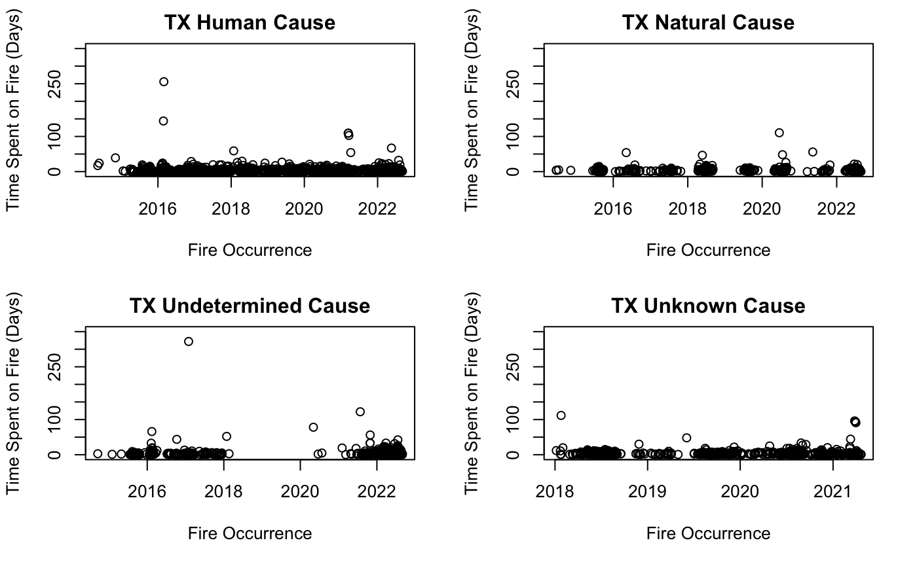
Exploratory Data Analysis (EDA)
General Data Analysis

Slide 7
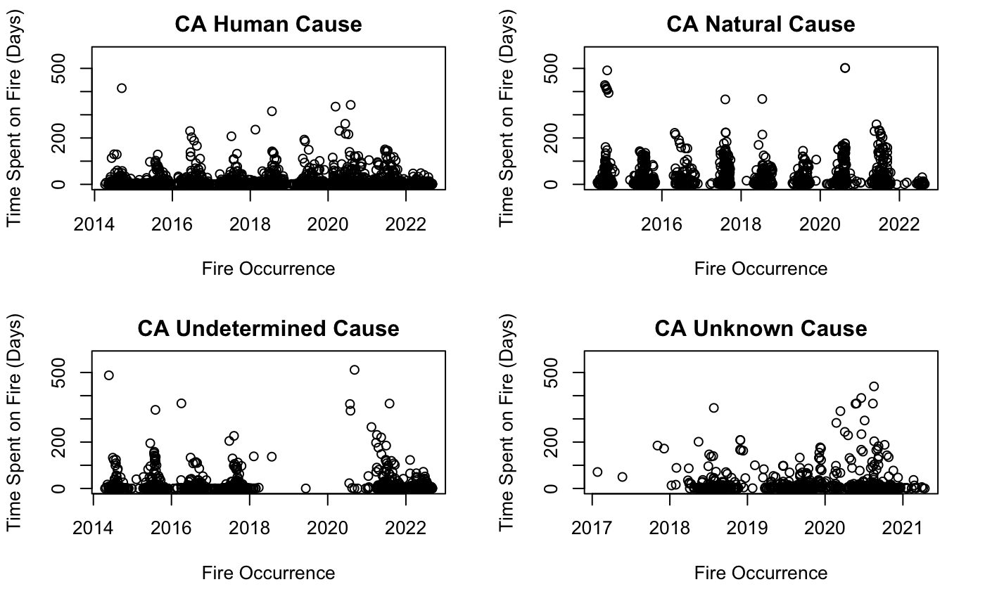
Exploratory Data Analysis (EDA)

Slide 8
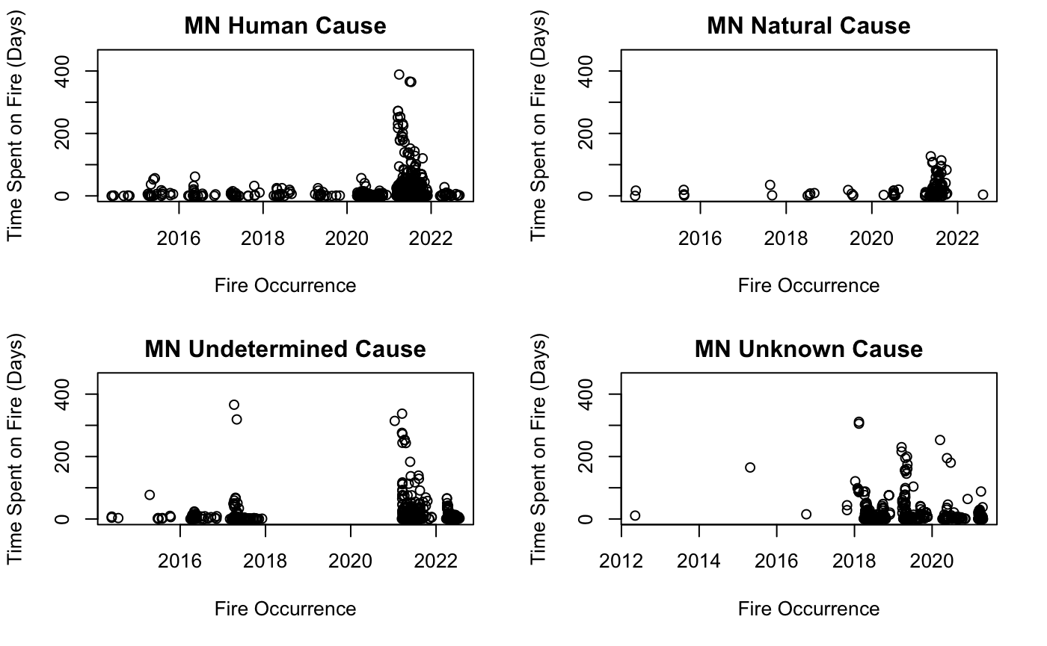
Exploratory Data Analysis (EDA)

Slide 9
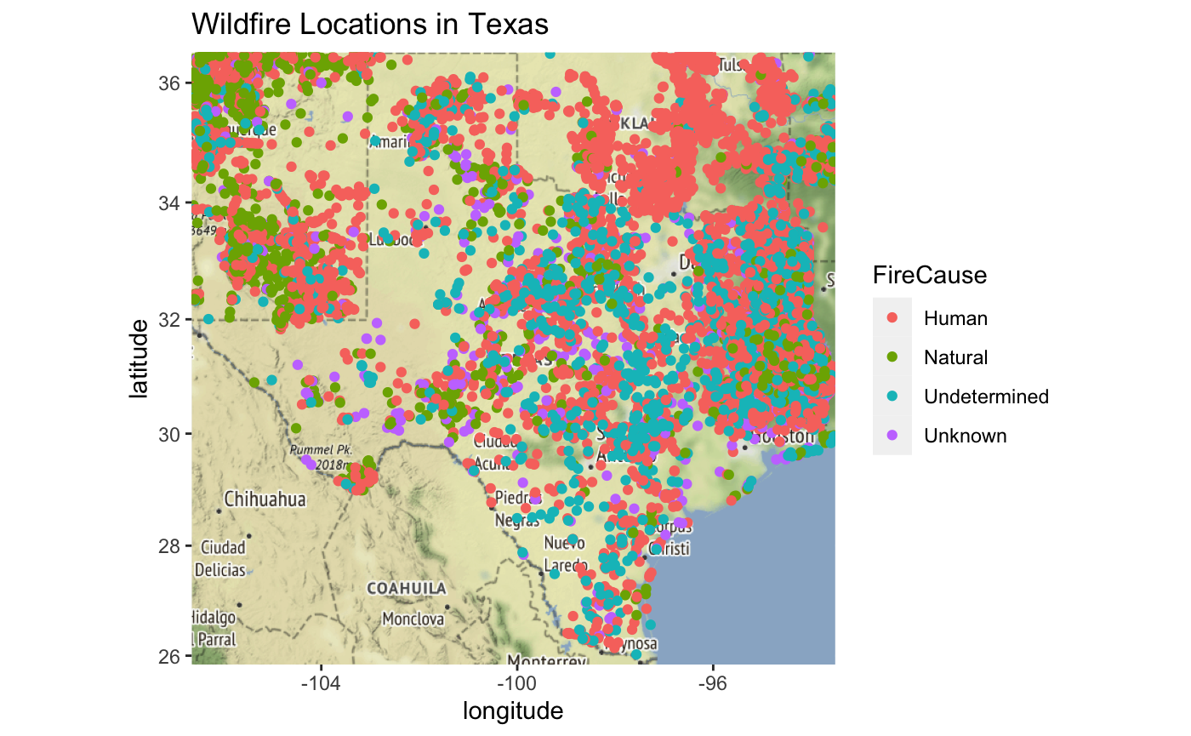
Exploratory Data Analysis (EDA)

Slide 10
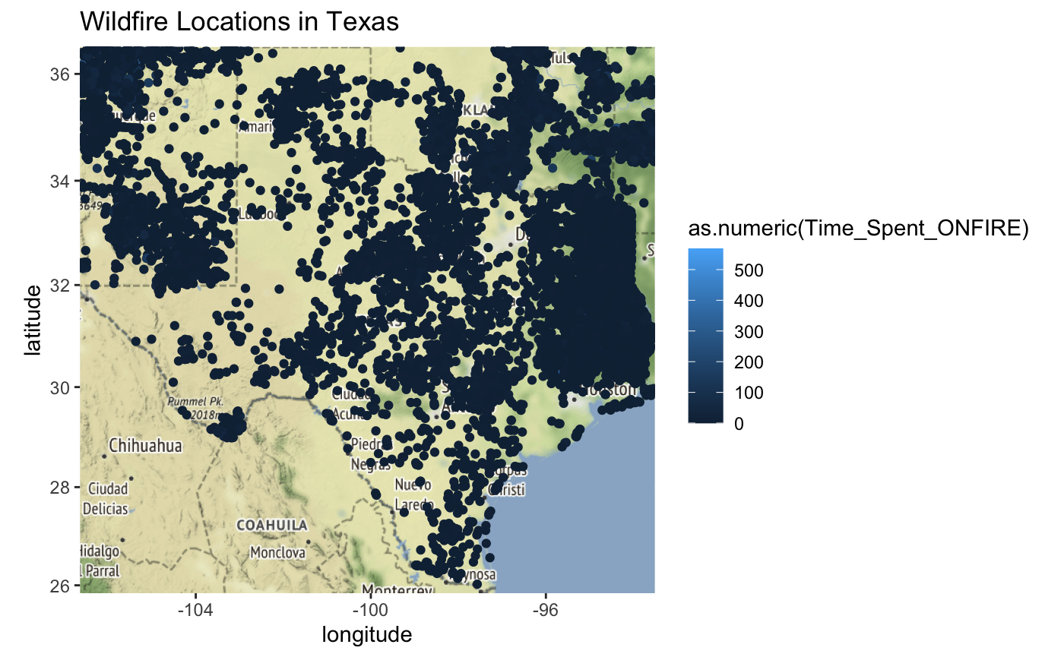
Exploratory Data Analysis (EDA)

Slide 11
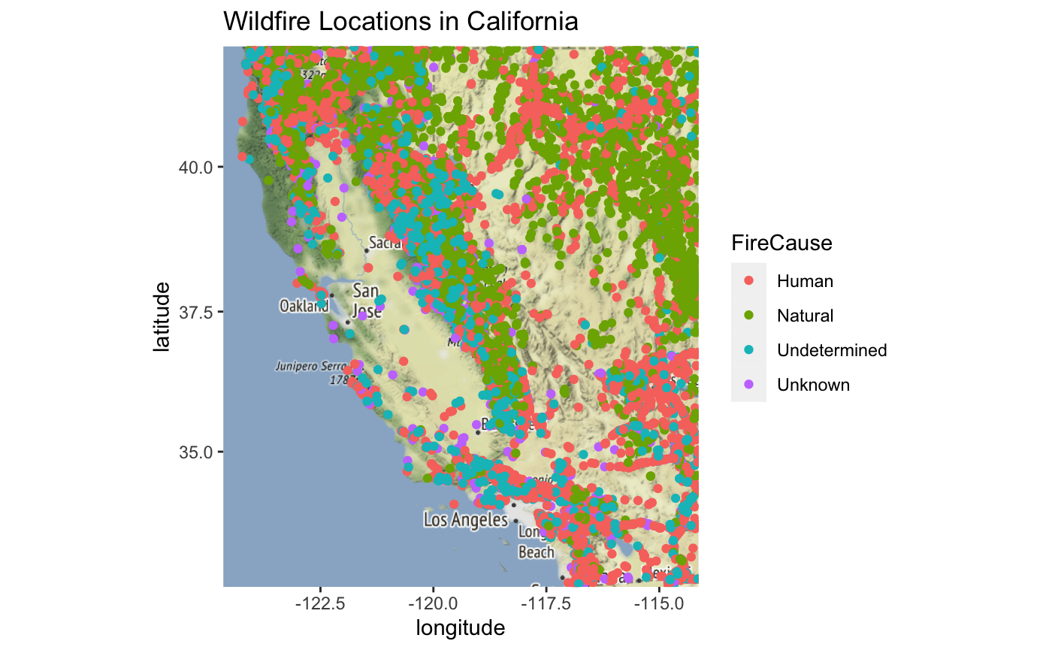
Exploratory Data Analysis (EDA)

Slide 12
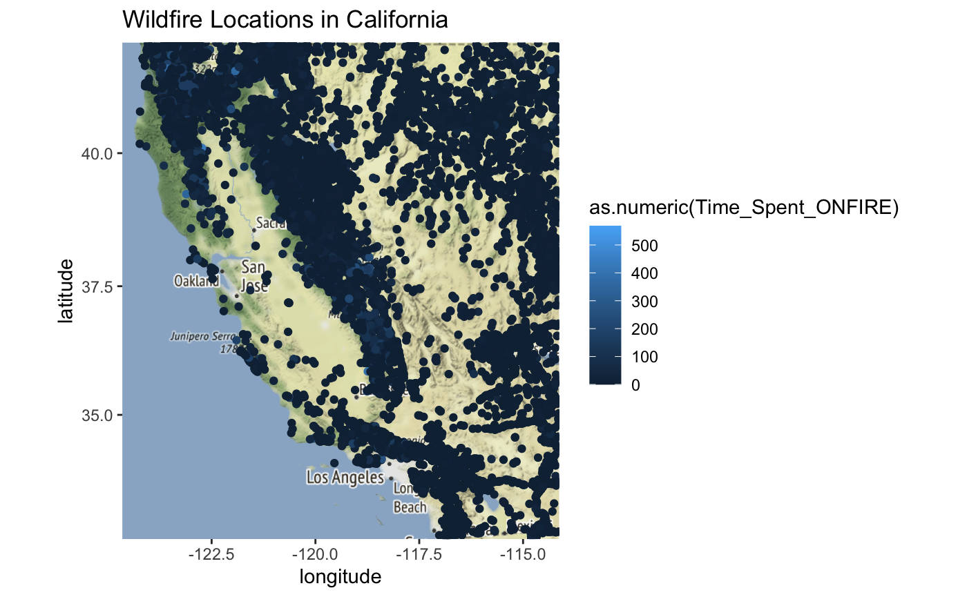
Exploratory Data Analysis (EDA)

Slide 13
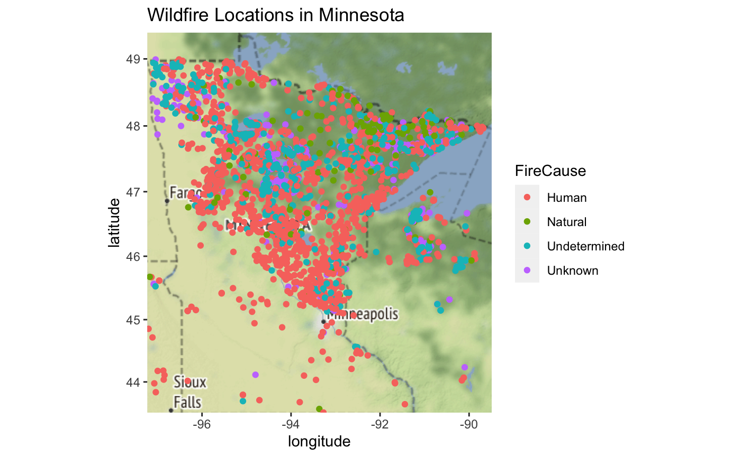
Exploratory Data Analysis (EDA)

Slide 14
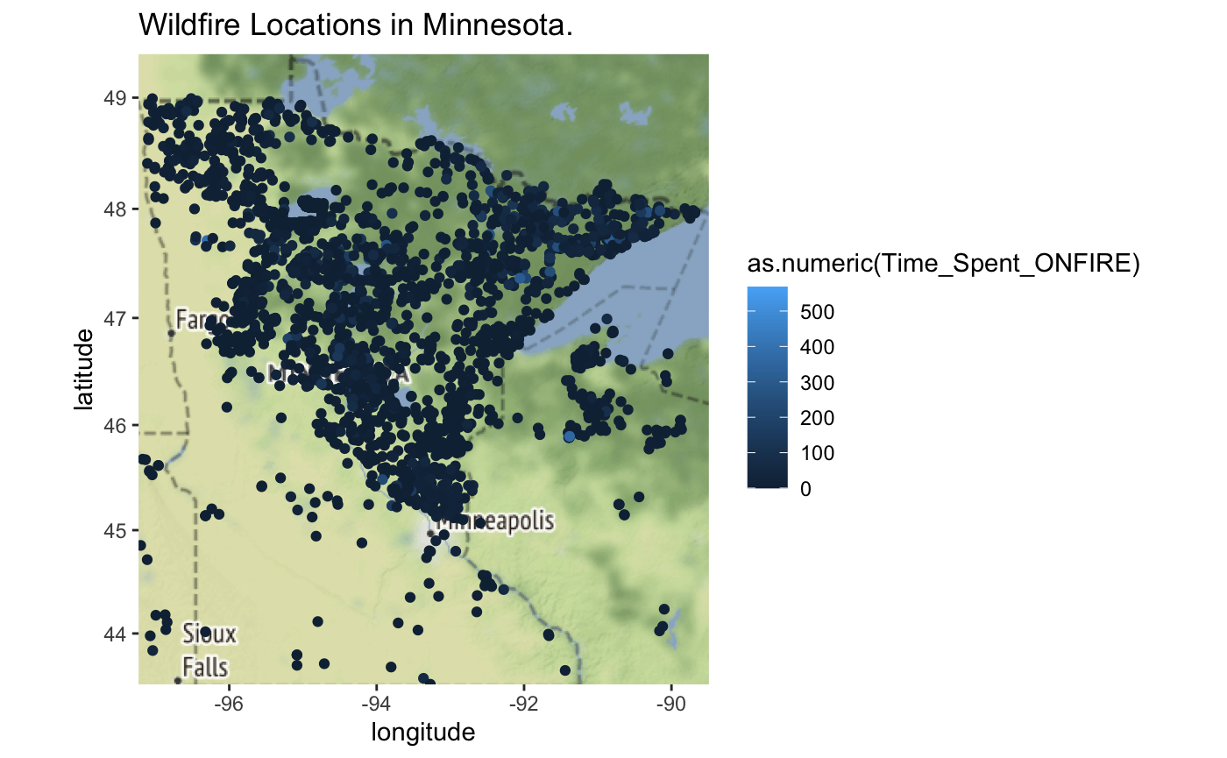
Exploratory Data Analysis (EDA)

Slide 15
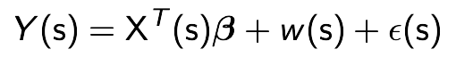
Data Modeling
Spatial Gaussian Regression Model
:
Time spent to put out the fire (days) at location s
:
Spatial random effect
:
Coordination (Lon,Lat) of location s
:
Random noise
:
Coefficients need to be estimated
Notes:
W(s) : to quantify if there is a spatial dependence between two locations
e(s): is a random noise

Slide 16

Data Modeling
:
Spatial random effect
Gaussian Process with mean = 0 and variance = 𝝈^2 * 𝙥 (r)
We will estimate 𝝈^2 : applying a simple linear regression model (fit.lm) not considering the data as a spatial data and take the variance of the output
We will estimate 𝙥 (r): applying exponential covariance function with the following parameters:
r = The distance between two locations for example S1 & S2
𝜙 = Spatial range parameter estimated as (the maximum distance / 3 * 2)
Notes:
What does p(r) means in words:
p(r) has value between zero and 1
So When the distance between two locations is very high … the covariance function will be close to 0 then the variance will be also close to zero that means that there is no spatial dependence between the two locations
As p(r) increase

Slide 17
Thank You

